Slide 1
Network Embedding (Graph Attention Network)
TA: Hongming ZHANG
Email: hzhangal@cse.ust.hk

Slide 2
Network Embedding
Input
Output
Notes:
In last week’s tutorial, we have briefly shown the idea of network embedding, which simply converts the nodes in a network into the embedding space.

Slide 3
Approaches
1. Random walk based
2. Graph CNN based
Many Others……
Notes:
As we introduced last week, there are many methods to d other graph embedding, like the random walk-based (DeepWalk and node2vec), graph CNN based methods, and many others. In today’s tutorial, I will introduce one of the graph CNN based method- graph attention network.

Slide 4
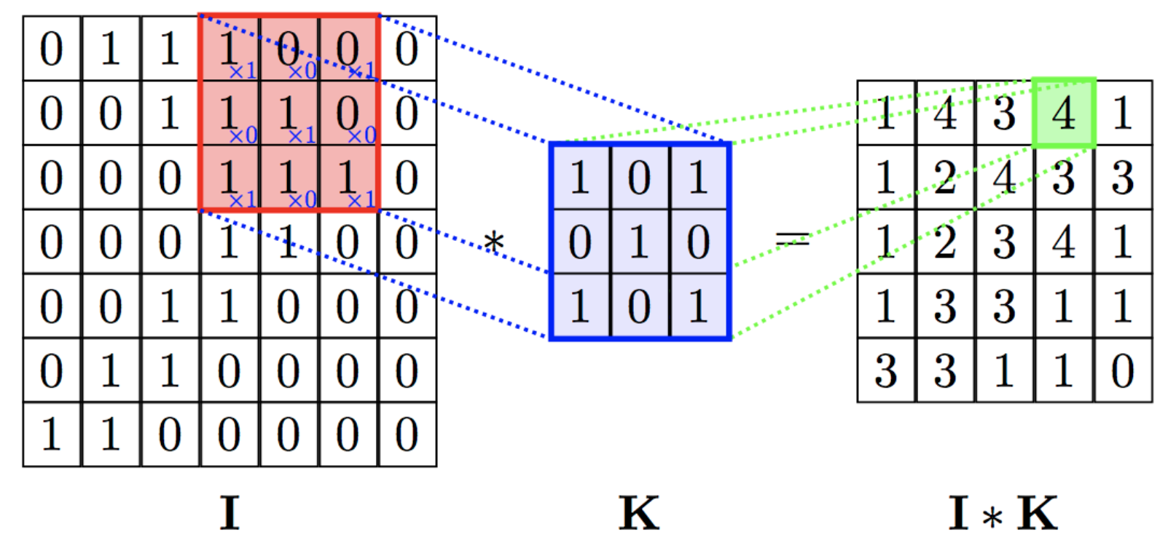
Review-CNN
Notes:
Before introducing the graph attention network, I firstly review what is CNN (convolutional neural network). Here is one simple example, we have a small window, which can go over the input data and generate a new representation. For the input.

Slide 5
Review-CNN
LeNet-5 for CV tasks (introduced in tut2)
CNN has been shown helpful for both computer and natural language processing tasks
Notes:
CNN has been shown very helpful in many computer vision and natural language processing tasks. For example, I believe that all of you have tried this LeNet-5 introduced in tutorial 2.

Slide 6
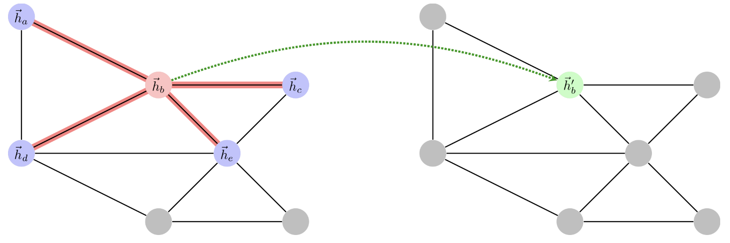
Apply CNN to graphs
Different from images or textual data, applying CNN to graphs is much more challenging due to the arbitrary structure of graphs. (each node may have different numbers of neighbors)
Notes:
The idea of applying CNN to graphs is very simple and trivel, but the implementation is difficult. In modern deep learning frameworks like keras and tensorflow, most of the operation are based on tensors and how to solve this problem with tensors can be chanllenging.

Slide 7
Graph Attention Networks (GAT)
P Veličković et al. - ‎2017. Graph Attention Networks, NIPS.
Targets on three challenges:
1. Fixed number of parameters (graph convolutional kernel)
2. Localisation (acting on a local neighbourhood of a node)
3. Ability to specify arbitrary importance to different neighbours
PS: The concept of graph attention and the derivations introduced in this tutorial will not be tested in the final exam.

Slide 8
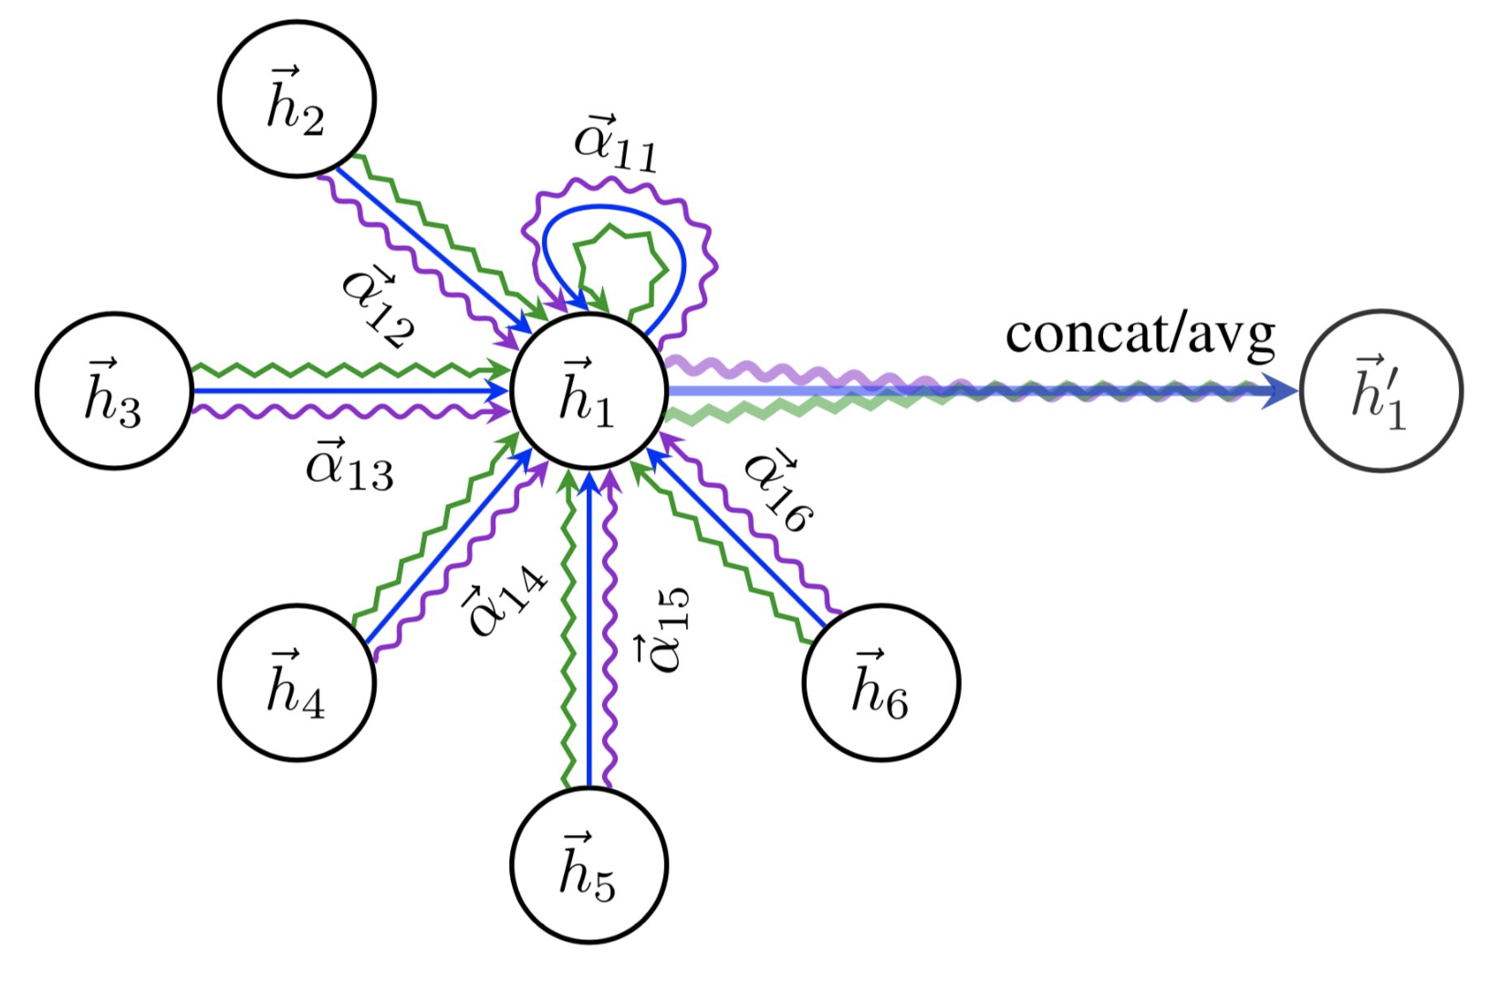
Graph Attention Networks (GAT)
1. Fixed number of parameters (graph convolutional kernel)
P Veličković et al. - ‎2017. Graph Attention Networks, NIPS.
Notes:
As shown in this example, the idea of GAT is very simple, we aggregate the information of neighbors into nodes. Besides the representation of nodes, all the other parameters are stored in this kernel, thus we can satisfity the first requirement.

Slide 9
Graph Attention Networks (GAT)
Center Node
2. Localisation (acting on a local neighbourhood of a node)
P Veličković et al. - ‎2017. Graph Attention Networks, NIPS.
Notes:
As shown in this example, we have 6 nodes in this sub-graph, where node 1 is the center nodes. Actually, we can treat different nodes as the center node one by one, thus we can satisfy the second requirement.

Slide 10
Graph Attention Networks (GAT)
weight
3. Ability to specify arbitrary importance to different neighbours
P Veličković et al. - ‎2017. Graph Attention Networks, NIPS.
Notes:
In the end, leveraging one attention module, GAT can learn the weight of different nodes. By doing so, different neighbor can have different influence on the center node.

Slide 11
In this Tutorial
1. Introduce the task of node classification.
2. Implement the GAT kernel.

Slide 12
Node classification
Input:
A base network
Labels for some of the training nodes
Features for all the nodes (Optional)
Output:
Prediction label for all the test nodes and embedding of all the nodes.
(the resulted embedding can also be used for other tasks.)

Slide 13
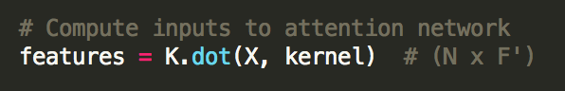
Convert initial embedding to a new embedding space
Input matrix [N, F]
One conversion matrix [F, F’]

Slide 14
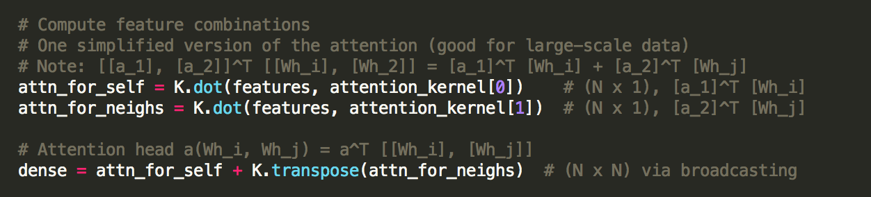
Attention module
A simplified version (more suitable for large-scale data)

Slide 15
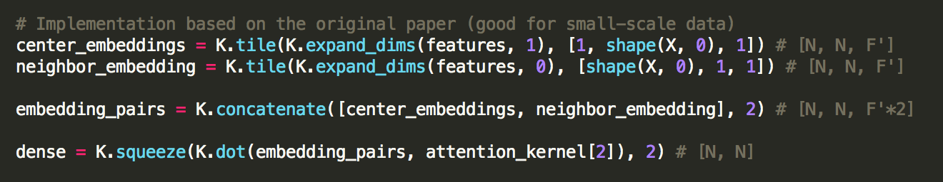
Attention module
Implementation based on the original paper

Slide 16
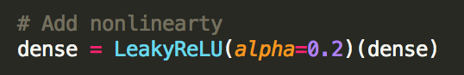
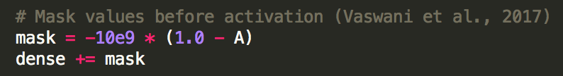
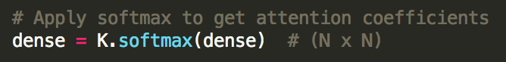
After that
Add nonlinearty
Select neighbors
Get attention with softmax

Slide 17
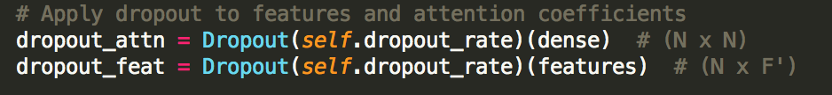


After that
Add dropout
Aggregate neighbor embeddings with attention
Add bias

Slide 18
Some suggestions
You can try GAT for the link prediction task, but you need to adjust the loss function by yourself.
Be careful when you apply GAT on large-scale data.
You can adjust the number of kernels, embedding size, dropout, biase or not ….

Slide 19
Project 2
AUC-ROC score on the validation set | Your Project 2 score
0.70 | 60
0.77 | 80
0.85 | 90
0.90 | 100
This is just for your reference, your final score will be given based on your performance on the test set, so do not overfit the dev data.
You are welcome to try different methods, but the methods introduced in the lecture/tutorial are enough.
If you are using DeepWalk/node2vec, try to tune all the possible parameters: embedding dimension, number of walks, window size, p, q, training iteration, etc…

Slide 20
Q&A

